Slide 1
CHAPTER ONE
Looking at Movies

Slide 2
Cinematic Language
The visual vocabulary of film
Composed of myriad integrated techniques and concepts
Connects the viewer to the story while deliberately concealing the means by which it does so.

Slide 3
Actively Looking at Movies
Recognize the many tools and principles that filmmakers employ to tell stories, convey information and meaning, and influence emotions and ideas.
Understand movies as narrative, as artistic expression, and as a reflection of the cultures that produce and consume them.

Slide 4
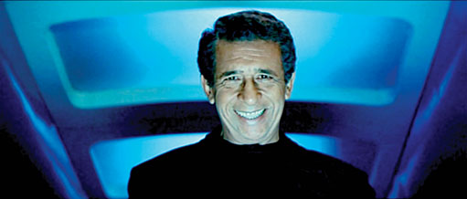
Notes:
Krrish (2006). Rakesh Roshan, director. Bollywood’s cinematic traditions, such as addressing the viewer, differ from Hollywood’s. Krrish, © 2006 Film Kraft.

Slide 5
What Is a Movie?
A popular entertainment
A narrative
A presentation of a story affected by cultural differences
An art form influenced by less conventional approaches and emerging technologies

Slide 6
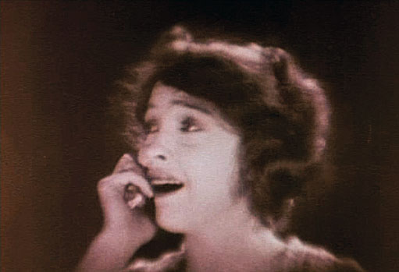
Notes:
Way Down East (1920). D. W. Griffith, director. Motion picture: a series of still images that, when viewed in rapid succession, the human eye and brain see as fluid movement. Way Down East, © 1920 D. W. Griffith Productions.

Slide 7
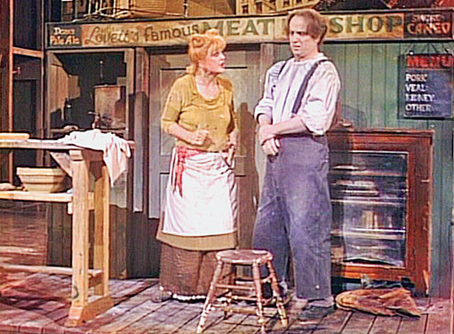
Notes:
Sweeney Todd: The Demon Barber of Fleet Street. Stephen Sondheim, director. A viewer of a theatrical production has only one unchanging view of the action.

Slide 8
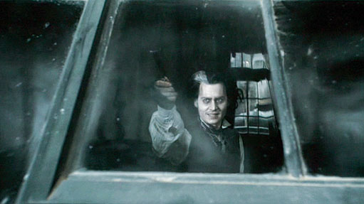
Notes:
Sweeney Todd: The Demon Barber of Fleet Street (2007). Tim Burton, director. Movies allow the same scene more sequences, points of view, and emotional expression. Sweeney Todd, © 2007 Dreamworks Pictures.

Slide 9
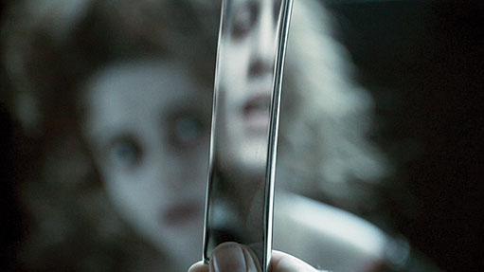
Notes:
Sweeney Todd: The Demon Barber of Fleet Street (2007). Tim Burton, director. Sweeney Todd, © 2007 Dreamworks Pictures.

Slide 10
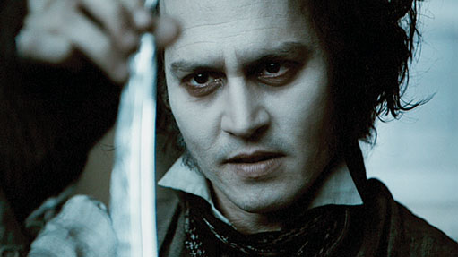
Notes:
Sweeney Todd: The Demon Barber of Fleet Street (2007). Tim Burton, director. Sweeney Todd, © 2007 Dreamworks Pictures.

Slide 11
Film Analysis
Analysis – the act of taking something complicated apart to figure out what it is made of and how it all fits together.
Step 1 – Identify the tools and techniques within a scene, sequence, or movie
Step 2 – Investigate the function and potential effect of that combination

Slide 12
Basic Construction of a Movie
Shots – unbroken span of action captured by an uninterrupted run of a motion-picture camera
Editing – the joining together of discrete shots
With each transition from one shot to another, a movie is able to move the viewer through time and space

Slide 13
Invisibility and Cinematic Language
Movies rely heavily on largely invisible techniques that convey meaning intuitively
Fade-in / Fade-out – viewers understand that significant story time has elapsed
Low-angle shot – viewers associate power with figures that they must literally look up to
Cutting on action – common editing technique designed to hide the instantaneous and potentially jarring shift from one camera viewpoint to another

Slide 14
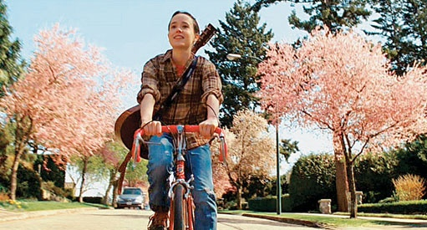
Notes:
Juno (2007). Jason Reitman, director. Juno, presented from a low angle for the first time, emphasizing her newfound freedom and empowerment. Juno, © 2007 Dancing Elk Productions/ FOX.

Slide 15
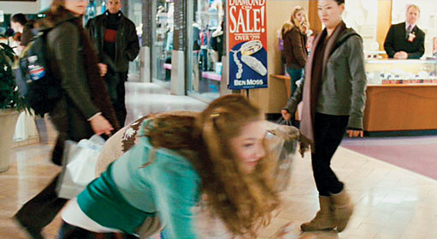
Notes:
Juno (2007). Jason Reitman, director. Invisible editing: cutting on action in Juno. Juno, © 2007 Dancing Elk Productions/ FOX.

Slide 16
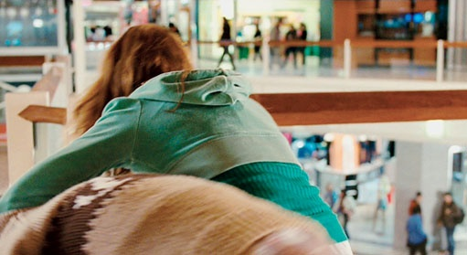
Notes:
Juno (2007). Jason Reitman, director. Juno, © 2007 Dancing Elk Productions/ FOX.

Slide 17
Cultural Invisibility
Filmmakers favor stories and themes that reinforce viewers’ shared belief systems

Slide 18
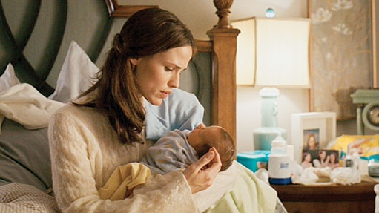
Notes:
Juno (2007). Jason Reitman, director. Juno ultimately upholds common cultural values: traditional family structures and robust individualism. Juno, © 2007 Dancing Elk Productions/ FOX.

Slide 19
Implicit and Explicit Meaning
No matter how many different layers of meaning are in a movie, each layer is either implicit or explicit.
Implicit – lies below the surface of a movie’s story and presentation, more interpretive than explicit meaning
Explicit – available on the surface of the movie, obvious

Slide 20
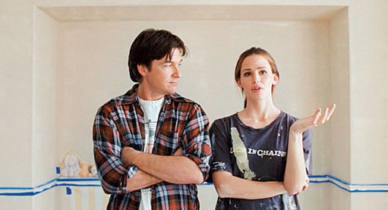
Notes:
Juno (2007). Jason Reitman, director. Explicit detail and implied meaning in Juno. Juno, © 2007 Dancing Elk Productions/ FOX.

Slide 21
Viewer Expectations
Viewers harbor essential expectations concerning a film’s form and organization
Viewers must be alerted to these expected patterns in order to fully appreciate the significance of deviations

Slide 22
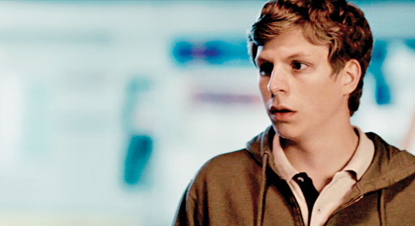
Notes:
Juno (2007). Jason Reitman, director. Viewer expectations: actors and the characters they portray. Juno, © 2007 Dancing Elk Productions/ FOX.

Slide 23
Formal Analysis
The analytical approach primarily concerned with film form
Form – the means by which a subject is expressed
Every element in every frame is there for a reason

Slide 24
Notes:
Juno (2007). Jason Reitman, director. Explicit intent: to convey setting and time of day. Juno, © 2007 Dancing Elk Productions/ FOX.

Slide 25
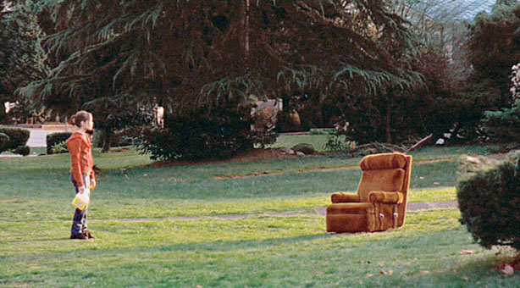
Notes:
Juno (2007). Jason Reitman, director. Implicit meaning: Juno as alienated or off-balance as informed by the shot compositions. Juno, © 2007 Dancing Elk Productions/ FOX.

Slide 26
Formal Analysis: Waiting-Room Sequence in Juno
13 shots, 30 seconds of film time
The formal analysis shows us how the filmmakers conveyed how the seemingly insignificant fingernail factoid infiltrates Juno’s thoughts and ultimately drives her from the clinic.

Slide 27
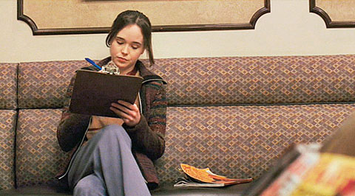
Notes:
Juno (2007). Jason Reitman, director. The camera dollies in, which enlarges Juno in frame, increasing her visual significance. Juno, © 2007 Dancing Elk Productions/ FOX.

Slide 28
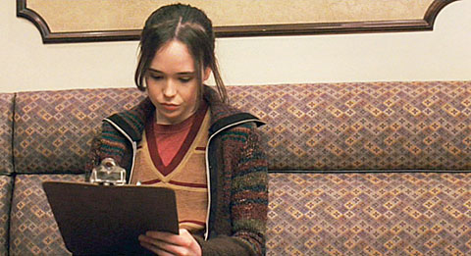
Notes:
Juno (2007). Jason Reitman, director. The shot’s relatively long 10-second duration sets up a relaxed rhythm that will shift later along with her state of mind. Juno, © 2007 Dancing Elk Productions/ FOX.

Slide 29
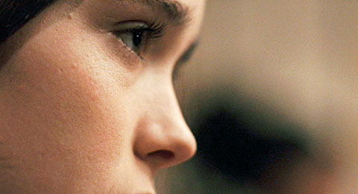
Notes:
Juno (2007). Jason Reitman, director. The obtrusive drumming sound motivates a startling cut, right up into Juno’s face. Juno, © 2007 Dancing Elk Productions/ FOX.

Slide 30
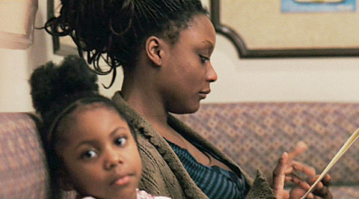
Notes:
Juno (2007). Jason Reitman, director. Point of view shot of a mother. The unnaturally loud drumming sound signals that we’ve begun to experience Juno’s psychological perceptions. Juno, © 2007 Dancing Elk Productions/ FOX.

Slide 31
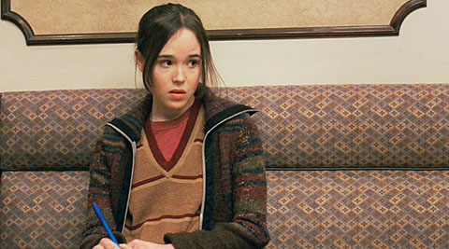
Notes:
Juno (2007). Jason Reitman, director. The juxtaposition connects her anxious expression to both the drumming mother and the little girl’s gaze. Juno, © 2007 Dancing Elk Productions/ FOX.

Slide 32
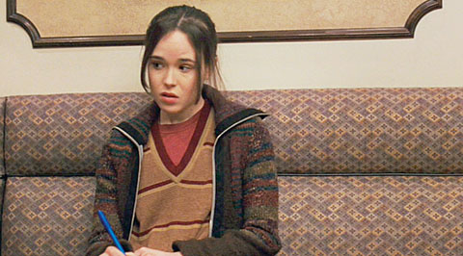
Notes:
Juno (2007). Jason Reitman, director. A character’s moment of realization. Within half a second, another noise joins the mix. Juno, © 2007 Dancing Elk Productions/ FOX.

Slide 33
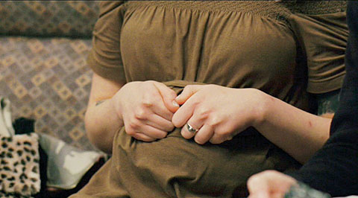
Notes:
Juno (2007). Jason Reitman, director. The unrealistically close viewpoint reflects the sight’s significance to Juno. Juno, © 2007 Dancing Elk Productions/ FOX.

Slide 34
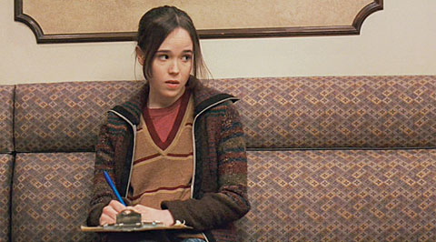
Notes:
Juno (2007). Jason Reitman, director. The camera continues to close in on Juno, and her gaze shifts again to follow yet another sound. Juno, © 2007 Dancing Elk Productions/ FOX.

Slide 35
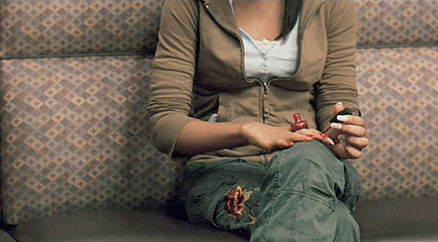
Notes:
Juno (2007). Jason Reitman, director. Again, a close-up psychological point of view. What would normally be a silent action emits a distinct, abrasive sound. Juno, © 2007 Dancing Elk Productions/ FOX.

Slide 36
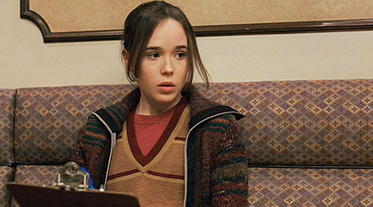
Notes:
Juno (2007). Jason Reitman, director. Juno is larger in the frame than we previously saw her. This break in pattern conveys a sudden intensification. Juno, © 2007 Dancing Elk Productions/ FOX.

Slide 37
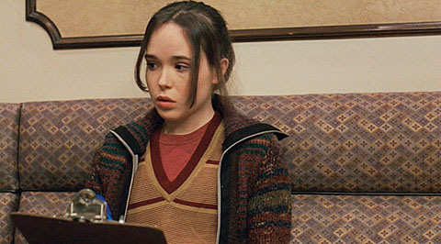
Notes:
Juno (2007). Jason Reitman, director. Juno’s head jerks as yet another, even more invasive sound enters the fray. Juno, © 2007 Dancing Elk Productions/ FOX.

Slide 38
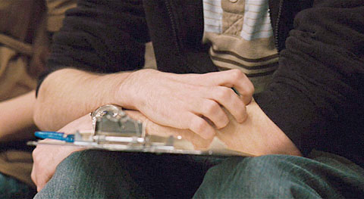
Notes:
Juno (2007). Jason Reitman, director. Another close-up point of view shot. The sequence’s patterns shifts. Juno, © 2007 Dancing Elk Productions/ FOX.

Slide 39
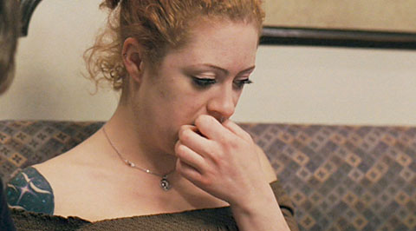
Notes:
Juno (2007). Jason Reitman, director. Instead of returning to Juno, the shots are of fingernails… Juno, © 2007 Dancing Elk Productions/ FOX.

Slide 40
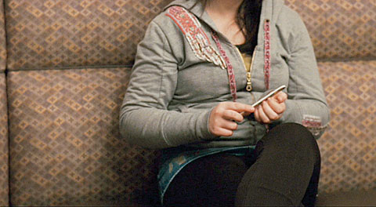
Notes:
Juno (2007). Jason Reitman, director. …louder in sound and shorter in duration than the previous shots. Juno, © 2007 Dancing Elk Productions/ FOX.

Slide 41
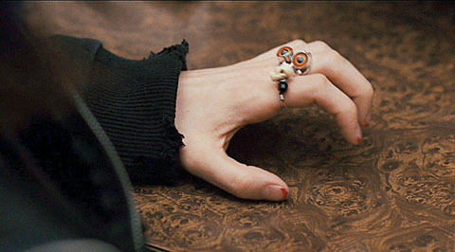
Notes:
Juno (2007). Jason Reitman, director. A woman’s hand drums her fingers nervously. Juno, © 2007 Dancing Elk Productions/ FOX.

Slide 42
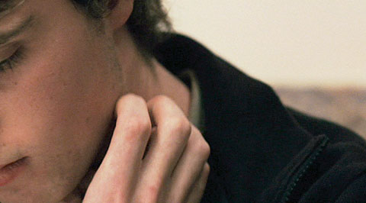
Notes:
Juno (2007). Jason Reitman, director. With every new shot, another noise is added to the sound mix. Juno, © 2007 Dancing Elk Productions/ FOX.

Slide 43
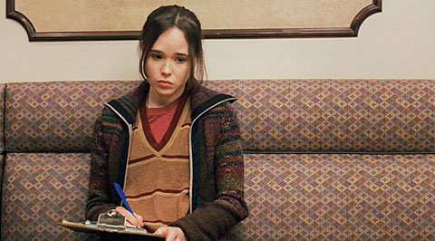
Notes:
Juno (2007). Jason Reitman, director. Break in pattern – Juno stares blankly ahead, rather than looking around her at the noises. Juno, © 2007 Dancing Elk Productions/ FOX.

Slide 44
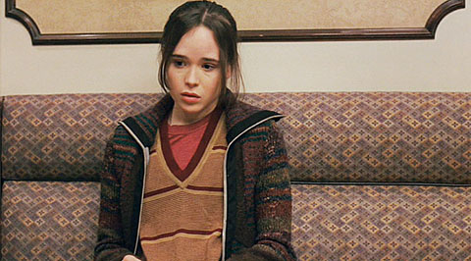
Notes:
Juno (2007). Jason Reitman, director. Break in pattern – Juno stares blankly ahead, rather than looking around her at the noises. Juno, © 2007 Dancing Elk Productions/ FOX.

Slide 45
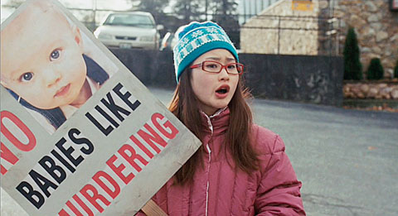
Notes:
Juno (2007). Jason Reitman, director. Jarring spatial, temporal, and visual shift with this cut – back to Su-Chin chanting in the parking lot. Juno, © 2007 Dancing Elk Productions/ FOX.

Slide 46
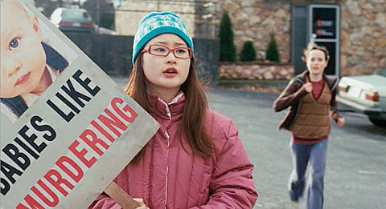
Notes:
Juno (2007). Jason Reitman, director. Before we can get our bearings, the camera pivots right to reveal Juno bursting out of the clinic door in the background. Juno, © 2007 Dancing Elk Productions/ FOX.

Slide 47
Alternative Approaches to Analysis
Alternative approaches analyze movies more as cultural artifacts than as traditional works of art
Explore cinema’s function within popular culture as well as the influence of popular culture on the movies

Slide 48
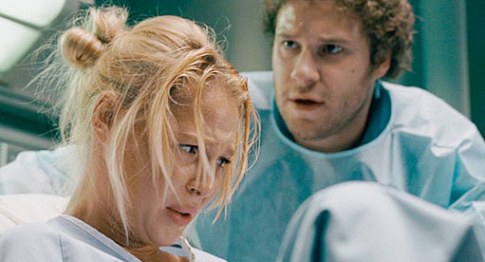
Notes:
Knocked Up (2007). Judd Apatow, director. Alternative analysis – Compare Juno with other 2007 American films that approached the subject with a similar blend of comedy and drama. Knocked Up, © 2007 Universal Pictures.

Slide 49
Review
1. What term describes the integrated techniques and concepts that connect us to the story while deliberately concealing the means by which it does?
a. Cinematic creativity
b. Cinematic narrative
c. Cinematic entertainment
d. Cinematic language
Notes:
ANS: D REF: Looking at Movies, Ch. 1, p. 3

Slide 50
Review
2. According to the text, even though every movie employs narrative in some form, what primarily affects how stories are presented?
a. Cultural values
b. Cinematic creativity
c. Cinematic language
d. Formal analyses
Notes:
ANS: A REF: What Is a Movie?, Ch. 1, p. 4

Slide 51
Review
3. Which of the following is NOT a device used for cinematic invisibility?
a. Cutting on action
b. Jump cut
c. Continuity of screen direction
d. fade-in
Notes:
ANS: B REF: Invisibility and Cinematic Language, Ch. 1, p. 7

Slide 52
Review
4. According to the text, if someone asked you to interpret a film or “say something arguable about it,” what kind of “meaning” are they looking for?
a. Conventional
b. Fundamental
c. Implicit
d. Explicit
Notes:
ANS: C REF: Implicit and Explicit Meaning, Ch. 1, p. 11

Slide 53
Review
5. Which of the following is a formal analysis option for Juno?
a. The movie’s treatment of class
b. The movie’s depiction of women and childbirth
c. The implications of the t-shirt messages displayed by the film’s characters
d. The motif of the empty chair that frames the story
Notes:
ANS: D REF: Alternative Approaches to Analysis, Ch. 1, p. 20

Slide 54
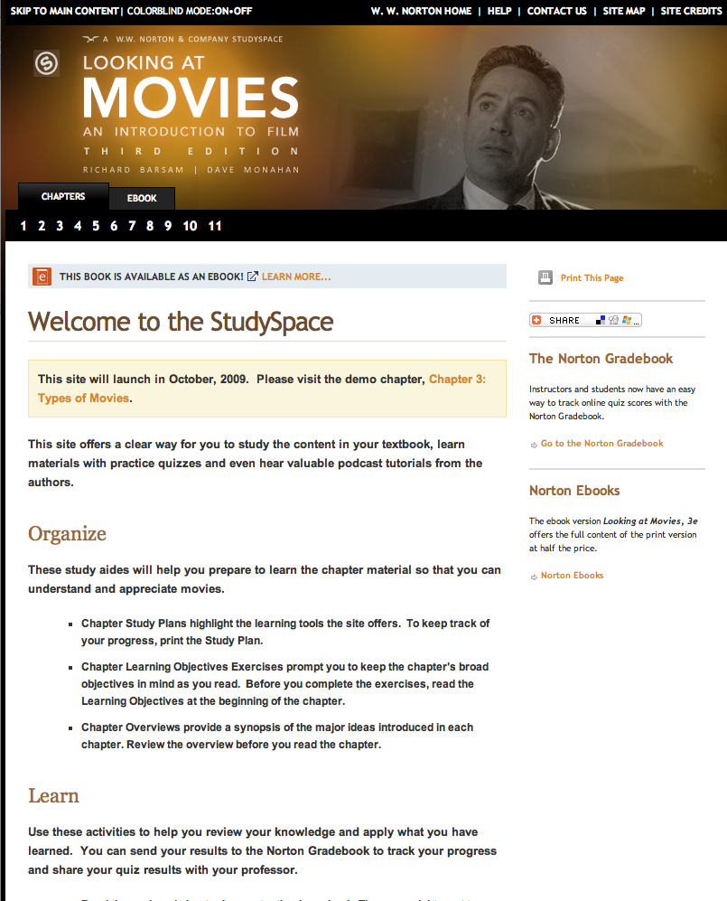
This concludes the Lecture PowerPoint presentation for Chapter 1
Visit the StudySpace at:
http://wwnorton.com/college/film/movies3/
© 2010 W. W. Norton Co., Inc.

