Slide 1
The Canterbury Tales ~Geoffrey Chaucer~

Slide 2
St. Thomas a’ Becket
Born – 1118 (date unknown)
Died - Dec. 29th 1170
The Archbishop of Canterbury (England)
Becket disagreed with King Henry II and was murdered in Canterbury Cathedral
There have been several miracles in this cathedral

Slide 3
St. Thomas a’ Becket
After all the miracles, a shrine was put up in the cathedral
Becket was canonized a saint
People set out on a pilgrimage, to Canterbury Cathedral to pay homage to the shire of St. Thomas a’ Becket. Some believed that shrine had healing powers

Slide 4
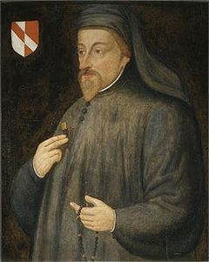
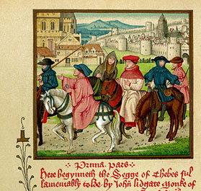
Geoffrey Chaucer
1387 Chaucer wrote a free-verse poem about a pilgrimage to St. Thomas a’ Becket’s shrine.
The Canterbury Tales

Slide 5
Canterbury Tales
Setting: April, The Tabard Inn
“Prologue”- 29 pilgrims, the narrator, and the inn host are introduced.

Slide 6
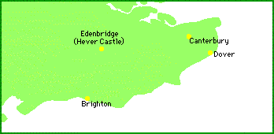
Canterbury, United Kingdom

Slide 7
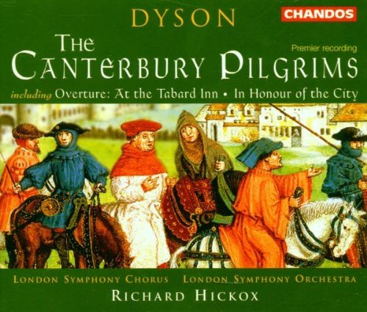

Slide 8
The Prologue
The 29 are spending the night at the Tabard Inn.
The Narrator says he will describe and repeat everything he hears no matter how offensive.
The Host proposes that each pilgrim tell 2 tales on the way there and back.
The best tale will win dinner at the Inn

Slide 9
The Prologue
The pilgrims are made up of all 3 divisions of class in medieval society:
Feudal class
The Church
Merchant class

Slide 10
The Prologue
Chaucer’s characterization was unlike anything ever written before.
He creates a human encyclopedia by describing physical, social mannerisms, beliefs, and morals of each character.

Slide 11
The Characters
After the pilgrims are introduced in the prologue each character tells his or her own tale.

Slide 12
Themes
Marriage-Chaucer was obsessed with relationships between men & women
Beast tales- Several character either acted like animals or were compared to and described with animal characteristics.

Slide 13
The Poems
Originally Chaucer set out to write approximately 120 tales but ended up with the 22 we have today.

