Slide 1
Allusions
Definition, Explanation, and Examples

Slide 2
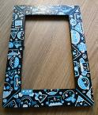
Allusions
Definition-a reference within a work to something famous outside it, such as a well-known person, place, event, story, or work of art, literature, music, pop culture.
Purpose-Lets reader/viewer understand new information, characters, plot, setting, etc. by connecting it to something already known.

Slide 3
Allusion “Problems”
Not to be confused with “ILLUSIONS”
In order to understand allusions, one must have a good grasp on “well-known” works of literature, art, music, pop culture, etc.
So, if one is not well-read, it will be difficult to fully grasp why an author/writer/director uses an allusion. This sometimes makes them difficult for high school students to grasp.

Slide 4
Allusion “Problems”
Allusions are NOT references to someone/something only a small group of people know.
So, you wouldn’t say, “Sally’s smile looked like my mom’s smile.”
While this is a method of comparison, it is not to something well-known (outside of your community).
=

Slide 5
Purpose of Allusions
Whenever you come across an allusion, stop and ask yourself:
What does the writer want me to understand about this character, setting, plot, etc. by connecting it to something with which I am already familiar?
What is the author’s purpose in using this allusion?
To create the same feeling/mood as the original work?
For comedic effect?
To show character’s motives or traits?

Slide 6
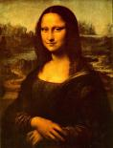
Allusion Examples
Sally had a smile rivaled only by that of the Mona Lisa.
Since everyone is familiar with the painting, they can imagine Sally’s almost expressionless smile.
What does this show about Sally?

Slide 7
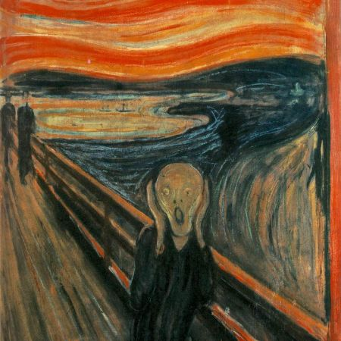
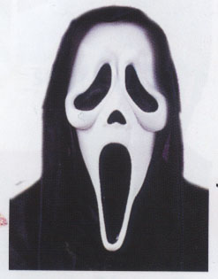
Allusion Example (Art to Film)
The makers of the Scream movie ALLUDED TO Munch’s work of art “The Scream” in order to instill fear.

Slide 8
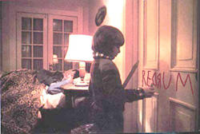
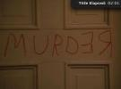
Allusions Example (TV to Film)
FAMILY GUY
THE SHINING
Danny writes “REDRUM” on the door at first.
Mirror reflection shows “Redrum”=
Murder backwards

Slide 9
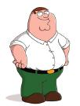
Family Guy/The Shining
The makers of Family Guy make Stewie’s blocks say “REDRUM” as an ALLUSION TO The Shining. They use this allusion because they know their audience will likely be familiar with The Shining, so they will understand the message that Stewie is obsessed with murder. REDRUM=MURDER backwards….as reflected in the mirror in The Shining.
This allusion helps the viewer gain a deeper understanding of Stewie’s character—a matricidal maniac!

Slide 10
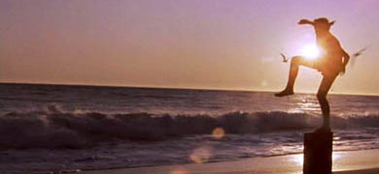
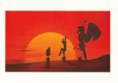
Allusions Example (Film to Film)
KARATE KID
DISNEY’S HERCULES
Hercules ALLUDES TO Karate Kid when Hercules is training. Disney uses this allusion so the viewer thinks of Karate Kid and how, after training in the sunlight, Daniel wins the big match. The allusion is used to FORESHADOW that Hercules will also be successful in his big fight.

Slide 11
Allusion Example (Poem to Book)
John Steinbeck’s Of Mice and Men book title alludes to Robert Burns’ poem “To a Mouse”
Burns’ poem lines:
The best laid schemes of mice and men often go awry
(Standard English Version)
Reason for allusion:
Steinbeck is trying to send the message, through his title, that things will not go as the characters planned. It foreshadows a not-so-happy ending in which dreams are dashed.

Slide 12
Allusion Example (Poem to Book)
Robert Burns is a popular one to make titular allusions
Not only does Steinbeck reference Burns’ work in Of Mice and Men, but the late J.D. Salinger also alludes to Burns’ poem “Comin’ through the Rye” with the title The Catcher in the Rye
In Chapter 22, Holden Caulfield tells his sister, Phoebe, when she asks what he wants to do with his life, “And that’s all I’d do all day….I’d just be the catcher in the rye and all.”

Slide 13
Allusion Example (Film to Book)
Peter Pan (Robin Williams) says, “What is this, some sort of the ‘Lord of the Flies’ Pre-school?”
Implications:
Land is run by kids
Savages with no adult influence
Abandoned without adult supervision

Slide 14
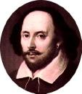
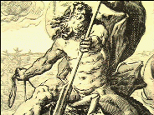
Most Popular Allusions
THREE MOST POPULARLY ALLUDED WORKS:
The Bible
Shakespeare
Greek/Roman Mythology
So, what does that tell you?
---You are expected to be well-read in order to understand many allusions!
POSEIDON,
God of Sea

Slide 15
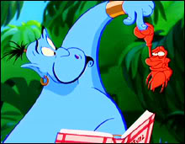
Shakespeare Allusion (Movie to Play)
“Et tu, Brute”
Latin for “And you, Brutus”
Said by Julius Caesar in Shakespeare’s play when he is about to die and realizes Brutus has betrayed him.
Used when people want to get the message across that someone has betrayed them
Another common betrayal allusion is to Judas Iscariot—the Biblical figure who betrayed Jesus with the “kiss of death” (another allusive phrase!)
In the scene in Aladdin where Genie is trying to make Aladdin a prince, he opens his recipe book. After the crab bites him, a robed hand comes out of the book, to which Genie says, “Et tu, Brute?” indicating that the recipe book has betrayed him, also, along with the crab. The purpose in this case, of course, is for comedic effect.

Slide 16
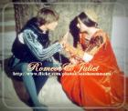
Shakespeare Allusion
Romeo and Juliet
Many ALLUDE TO Romeo and Juliet when there is a story of lovers who are not supposed to be together because of others’ objections.

Slide 17
Romeo and Juliet Song Allusions
* Arctic Monkeys' song 'I Bet You Look Good on the Dancefloor contains the lyrics 'Oh there ain't no love no, Montagues or Capulets/Just banging tunes in DJ sets’
* Madonna's “Cherish” has a line that says "Romeo and Juliet, they never felt this way, I bet.“
* Dire Straits' 1980 popular song "Romeo and Juliet" in which the singer looks back on a failed relationship.
* The Delta Goodrem song "I Don't Care" contains the lyrics "they tried to keep Romeo and Juliet apart...”
* The Blue Öyster Cult song "(Don't Fear) The Reaper" mentions Romeo and Juliet as being "Together in eternity".
* The song Ampersand by The Dresden Dolls, features the lines "and I may be romantic, and I may risk my life for it/but I ain't gonna die for you/you know I ain't no Juliet.“
* The band Genesis uses the names Romeo and Juliet for characters in the song 'The Cinema Show'
* The Big Audio Dynamite has in the song "The Bottom Line" a reference to Romeo (as well as a reference to the famous soliloquy in Hamlet).

Slide 18
Romeo and Juliet Song Allusions (cont’d)
* The Bon Jovi song "I'd Die For You" contains the lyrics "In a world that don't know Romeo and Juliet".
* The My Chemical Romance song “Our Lady of Sorrows” contains the line "...and die like star-crossed lovers when we fight...". Their song The Sharpest Lives also mentions the two in the line "Juliet loves the beat and the lust it commands, drop the dagger and lather the blood on your hands, Romeo.“
* The Semisonic song "Singing in my Sleep" alludes to the infamous balcony scene in the lines "I've been living in your cassette / It's the modern equivalent / Singing up to a Capulet on a balcony in your mind."
* The Reflections reached #6 on the pop charts in the summer of 1964 with the song "(Just Like) Romeo & Juliet“
* An Escape the Fate song called "Not Good Enough for Truth in Cliche" where the chorus reads: "...finger in the trigger to my dear Juliet. / Out from the window see her back drop silhouette, / This blood on my hands is something I cannot forget..."
*Hey Juliet by LMNT- "Hey Juliet, I think you’re fine, you really blow my mind..I just want you to know I wanna be your Romeo"

Slide 19
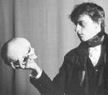
Shakespeare Allusion
HAMLET
“To be or not to be…”
Hamlet says this after he has discovered his uncle has killed his father and married his mother. He does not know whether or not he wishes to live on.
“To be”=Should I live on OR
“Not to be”=Should I commit suicide
Often ALLUDED TO when people are contemplating suicide in literature, art, movies, etc.

Slide 20
Shakespeare Allusive Phrases. These are Shakespeare Originals (Betcha didn’t know….)
Footloose and fancy free
Bottom of my heart
High and dry
Piece of cake
Budge an inch
Tongue-tied
Tower of strength
Hoodwinked
In a pickle
Knitted brow
Virtue of necessity
Fair play
Slept not one wink
Stood on ceremony
Laughed into stitches
Short shrift
Cold comfort
Too much of a good thing
Bag and baggage
High time
Long and short of it
The game is up
Flesh and blood
Lie low
Crack of dawn
Thick and thin
Foul play
Teeth set on edge
One fell swoop
Rhyme or reason
Good riddance
Send packing
Dead as a doornail
Eyesore
Laughing stock
Bloody-minded
Stony-hearted villain
Blithering idiot
By Jove
What the dickens

Slide 21
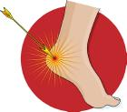
Mythology Allusions
Achilles’ Heel
Original Tale-When Achilles was a baby, it was foretold that he would die in battle from an arrow. Naturally, his mother Thetis did not want her son to die. So she took Achilles to a magical river which was supposed to offer powers of invincibility and dipped his body into the water. But as Thetis had held Achilles by the heel, his heel was not washed over by the water of the magical river. Achilles grew up to be a man of war who survived many great battles. But one day, an arrow shot at him was lodged in his heel, killing him instantly. Yet Achilles is remembered as one of the greatest fighters who ever lived.
When someone wants to discuss one’s weak point, s/he will refer to it as his/her “Achilles’ Heel,” meaning that they are strong in all areas except for that one tiny spot.

Slide 22
Mythology Allusions
Advertising uses allusions, too!
Venus alludes to the mythological Roman goddess principally associated with love, beauty, and fertility.

Slide 23
Mythology Allusions (Starter List)
Medusa
Mercury
Midas
Minerva
Parthenon
Pegasus
Phoenix
Poseidon
Saturn
Titans
Spartan
Trojan
Venus
Vulcan
Amazon
Aphrodite
Apollo
Arachne
Ares
Atlas
Delphi
Dionysus
Hercules
Hermes
Juno
Mars

Slide 24
Now, let’s see what Mythological allusions YOU can find. ☺

